Slide 1
MrDNA
Anacapa
QIIME
...
Ranacapa
STAMP
QIIME
Cytoscape
...

Slide 2
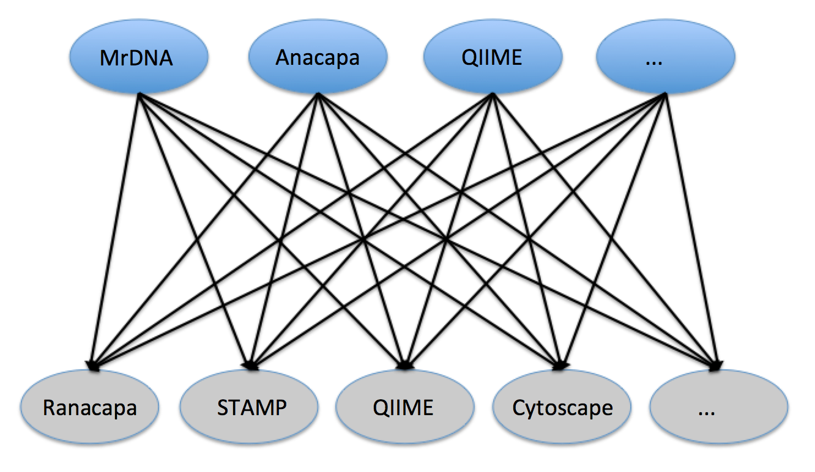
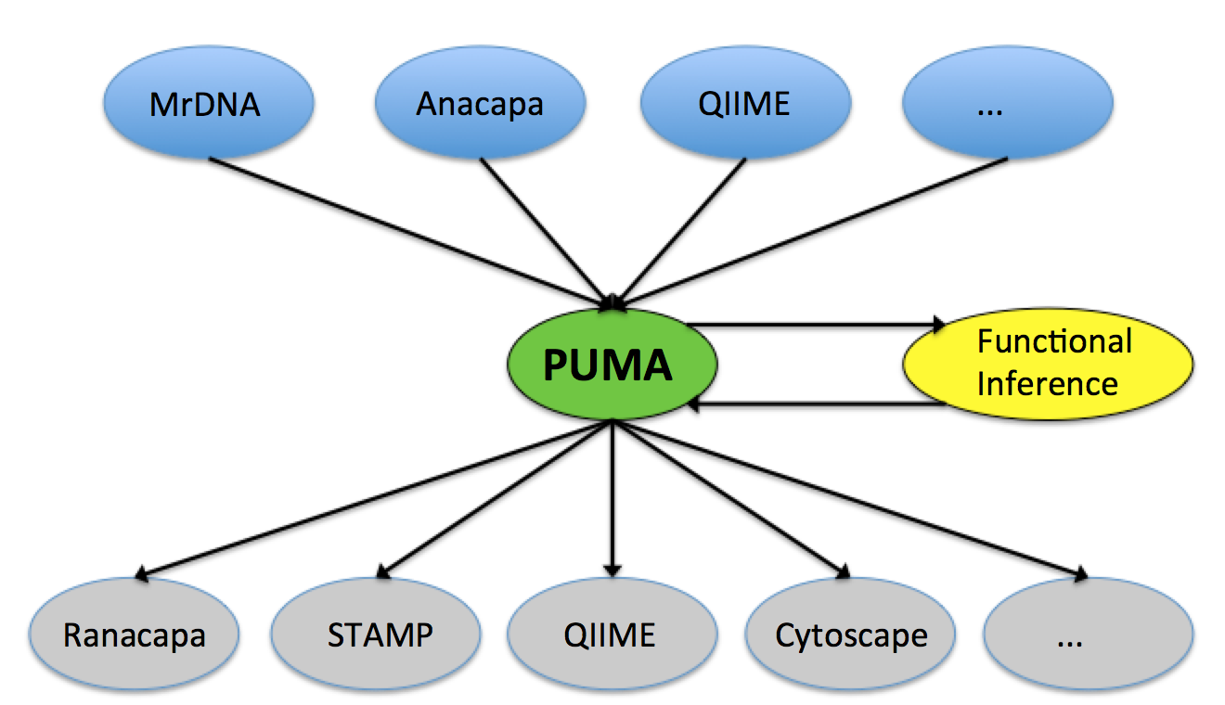
A
Taxonomic or Functional Platforms
Problem
Analysis or Visualization Platforms
B
Taxonomic or Functional Platforms
Solution
Analysis or Visualization Platforms

Slide 3
MrDNA
Anacapa
QIIME
...
PUMA
Functional Inference
Ranacapa
STAMP
QIIME
Cytoscape
...

Slide 4
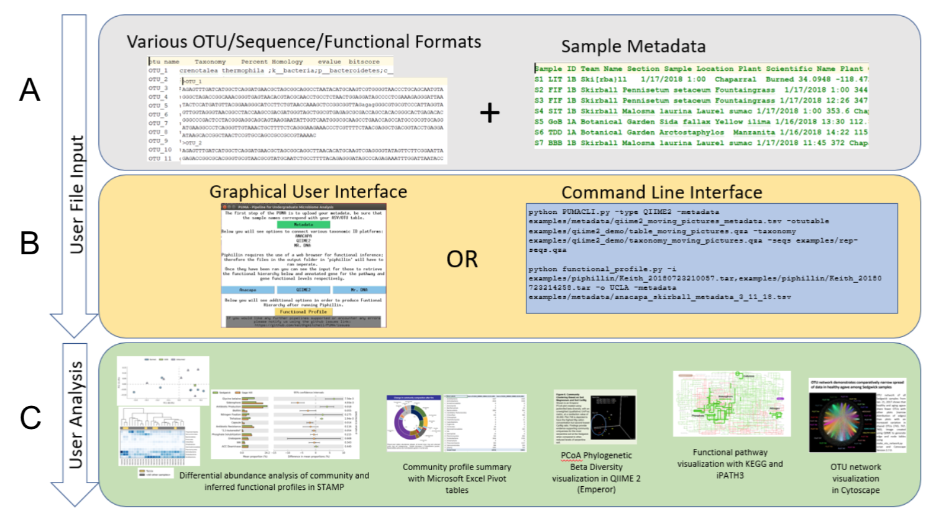

Slide 5
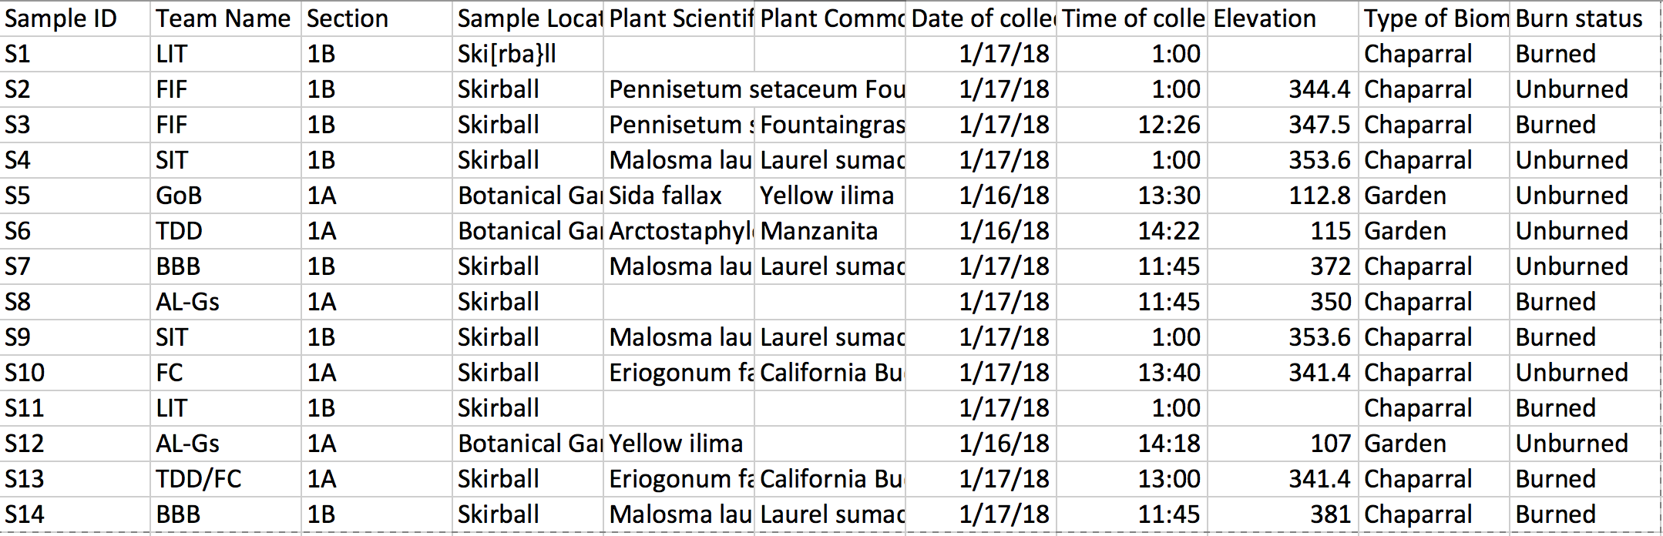
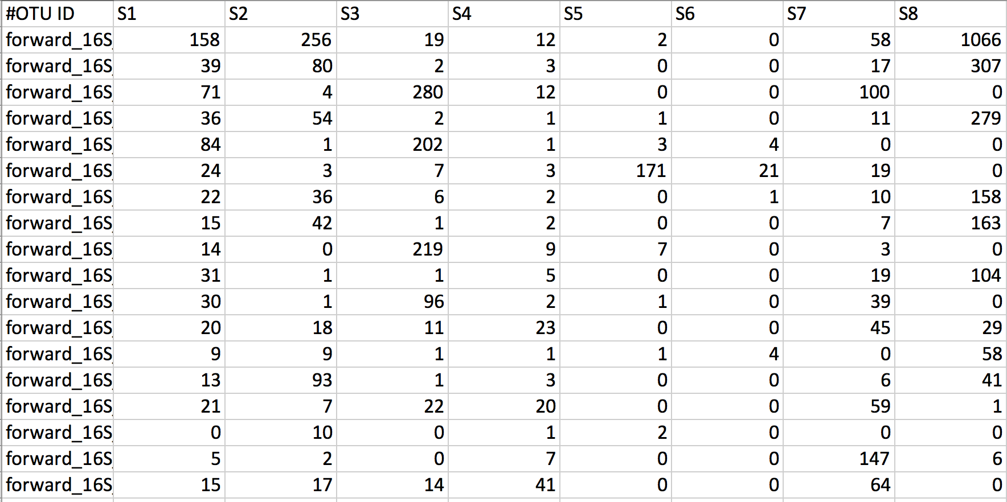
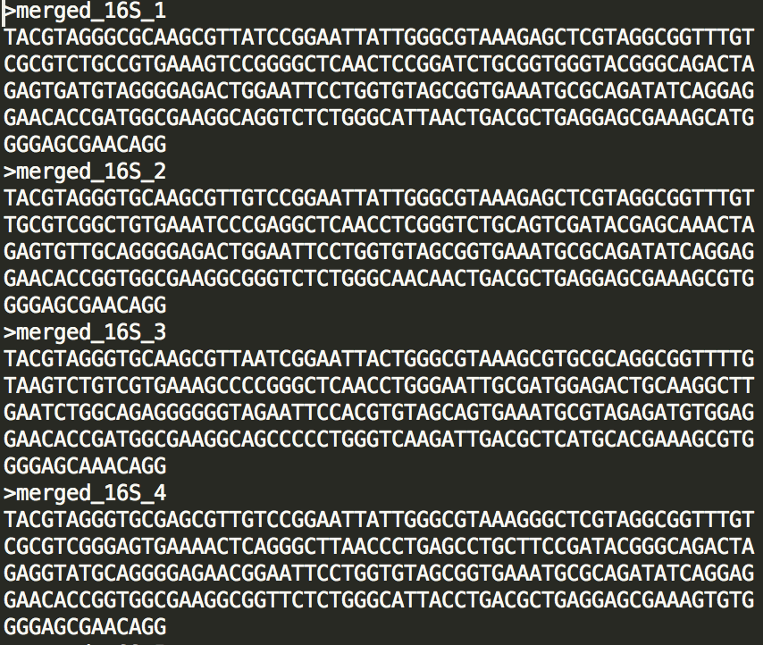
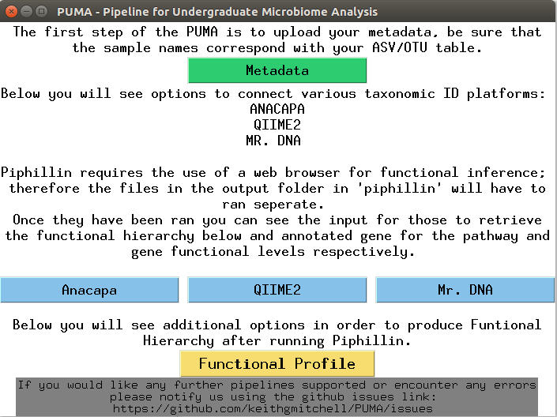
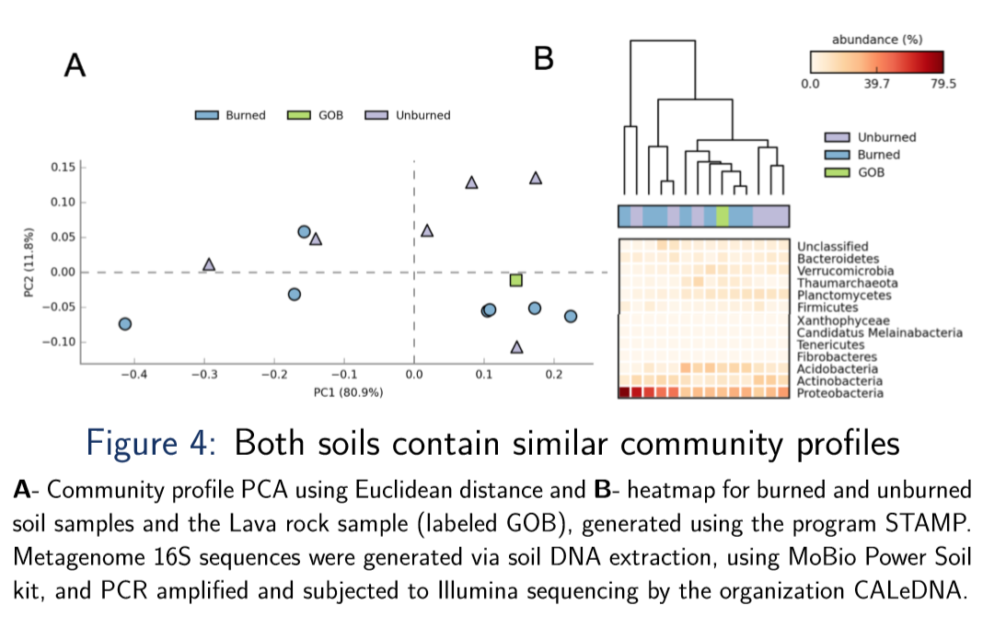
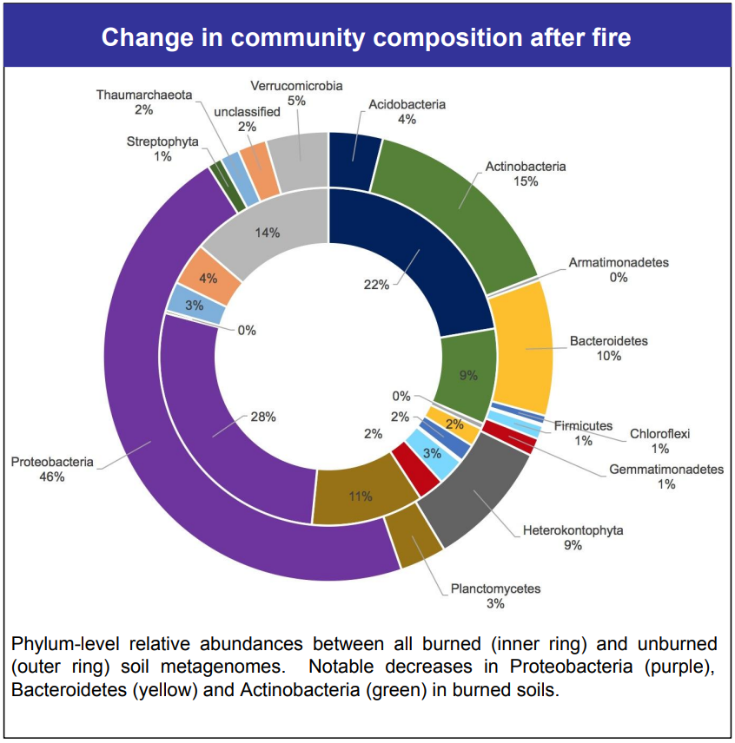
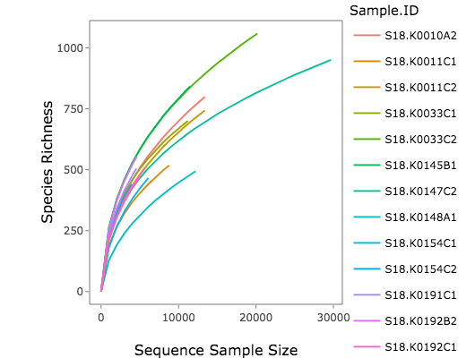
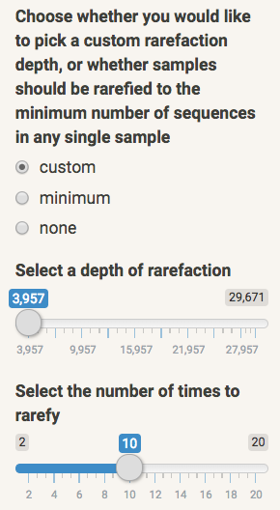
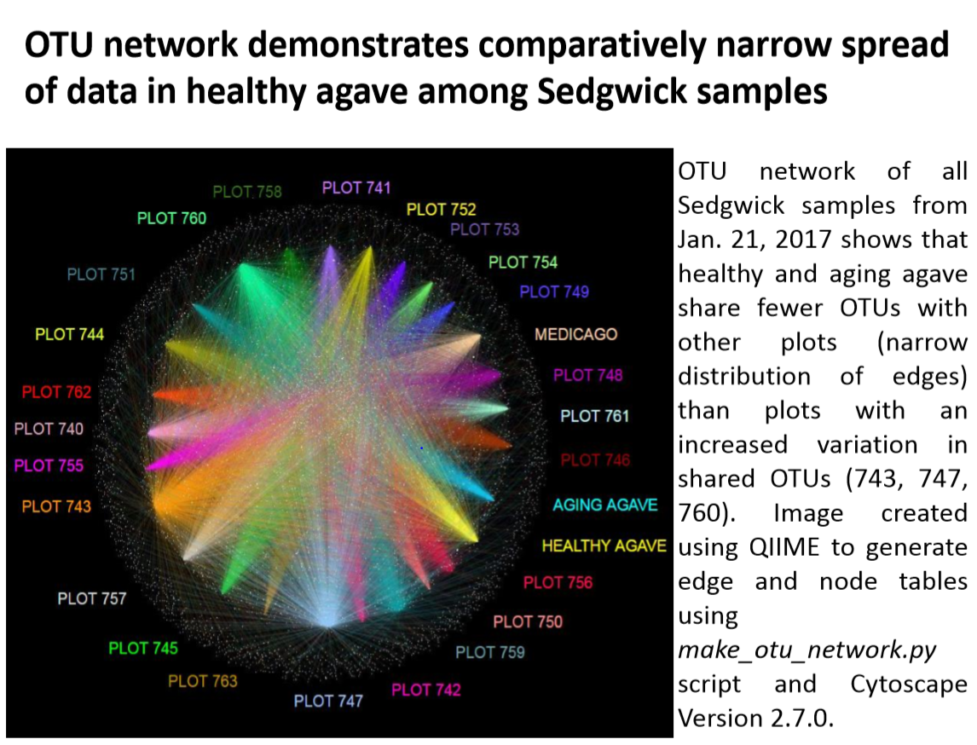
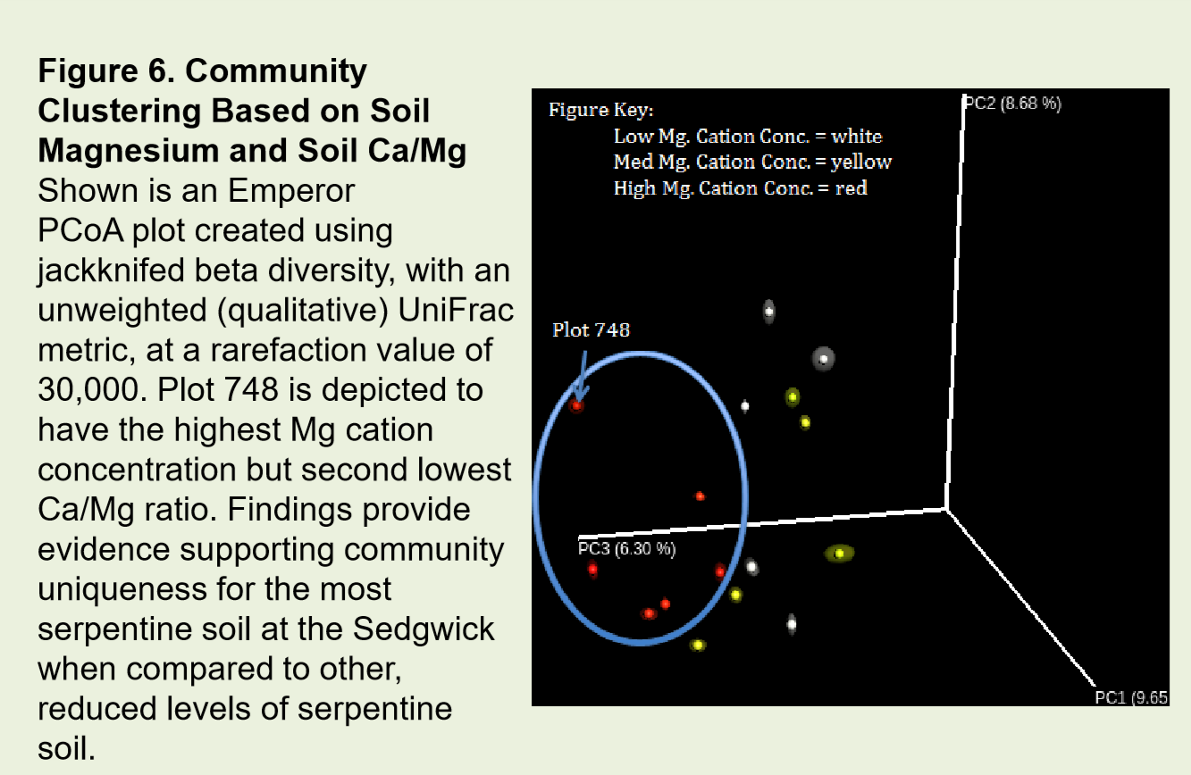
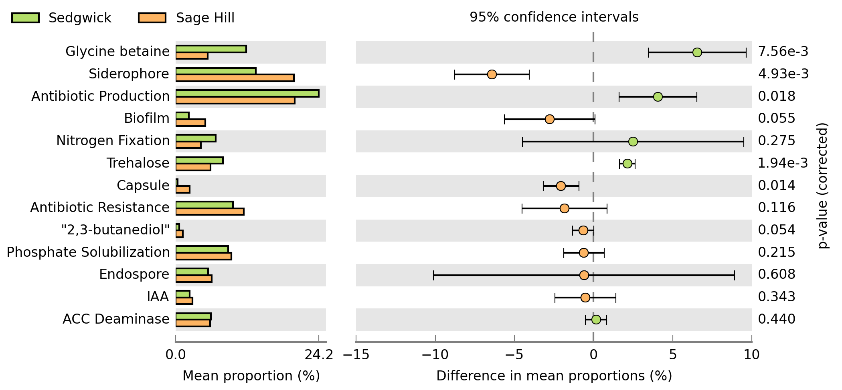
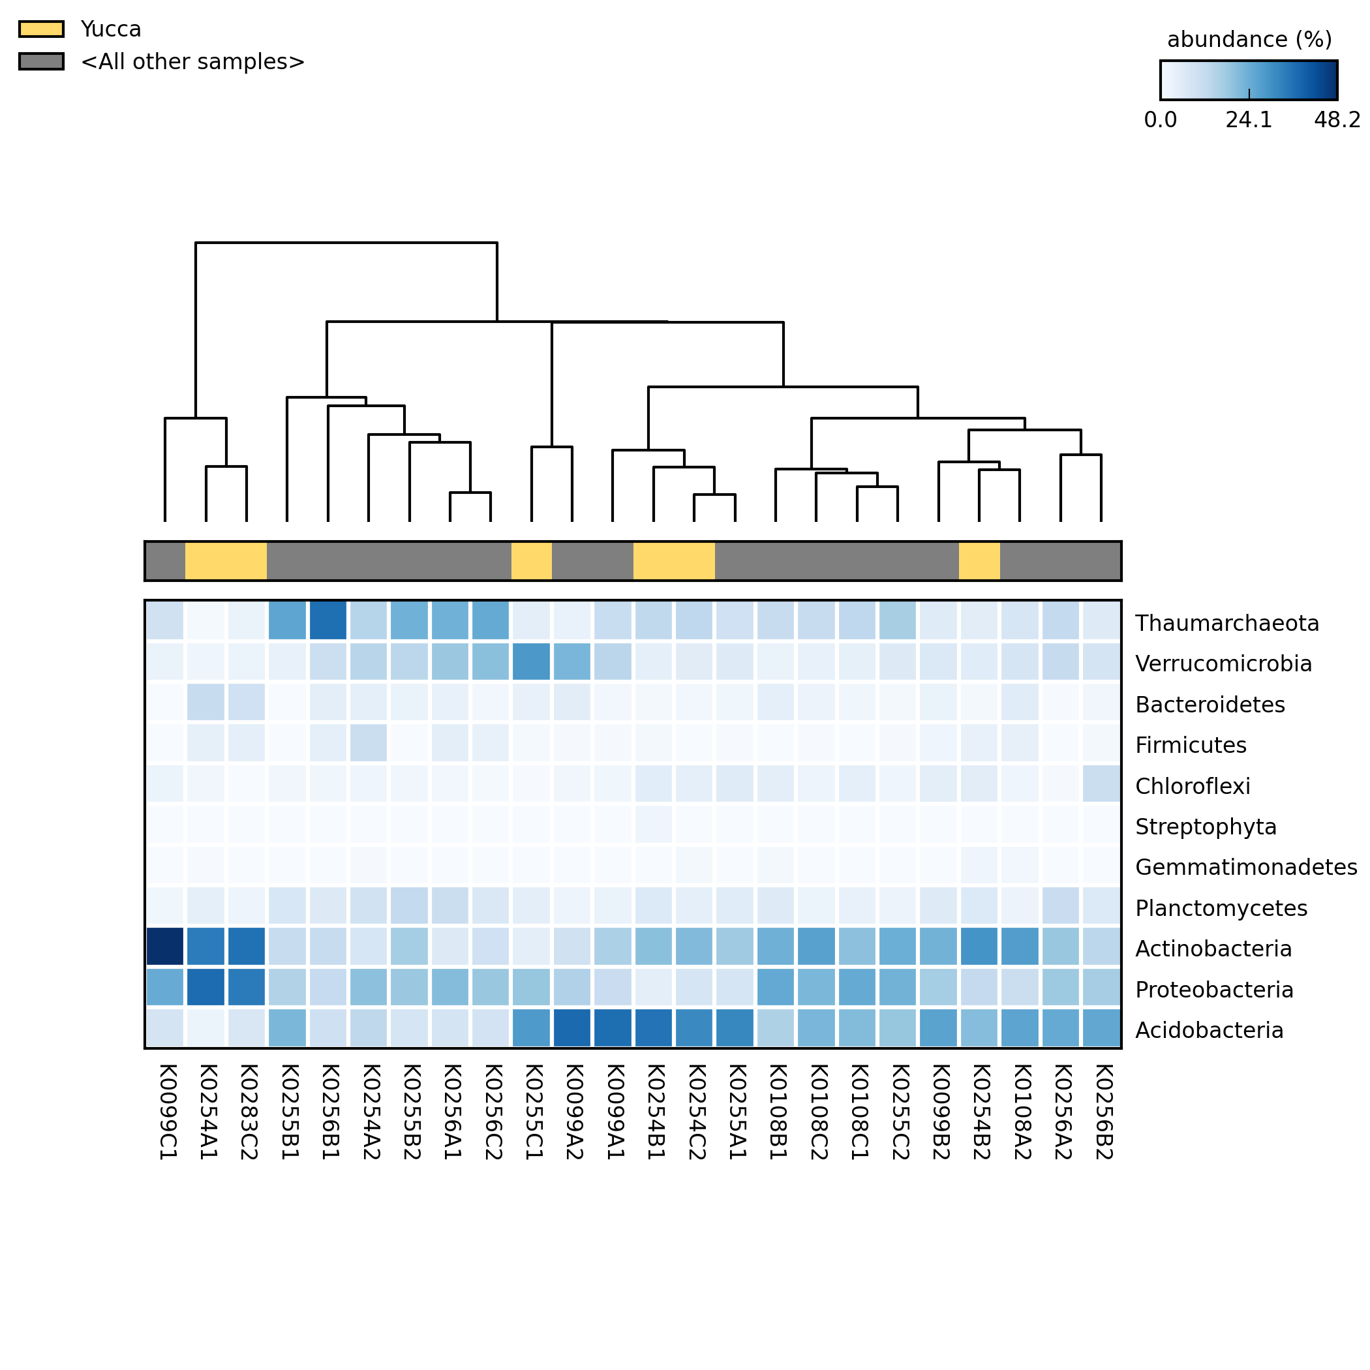
Various Abundance/Sequence/Functional Formats
Metadata
A
+
User File Input
Graphical User Interface
Command Line Interface
B
python PumaCLI.py -otutable examples/anacapa_skirball_S18/16S_ASV_raw_taxonomy_70.tsv \
-fwdseq examples/anacapa_skirball_S18/nochim_forward16S.fasta \
-mergeseq examples/anacapa_skirball_S18/nochim_merged16S.fasta \
-reverseseq examples/anacapa_skirball_S18/nochim_reverse16S.fasta \
-rarefactioniter 3 -rarefactiondepth 3500 \
-metadata examples/metadata/anacapa_skirball_metadata_3_11_18.tsv \
-type anacapa -unique_id demo -msa_phylo True
OR
C
User Analysis
Differential abundance analysis of community and inferred functional profiles in STAMP
Data exploration in ranacapa (R based web app)
OTU network visualization
in Cytoscape
Community profiles with Excel Pivot tables
PCoA Phylogenetic Beta Diversity visualization in QIIME 2 (Emperor)

Slide 6
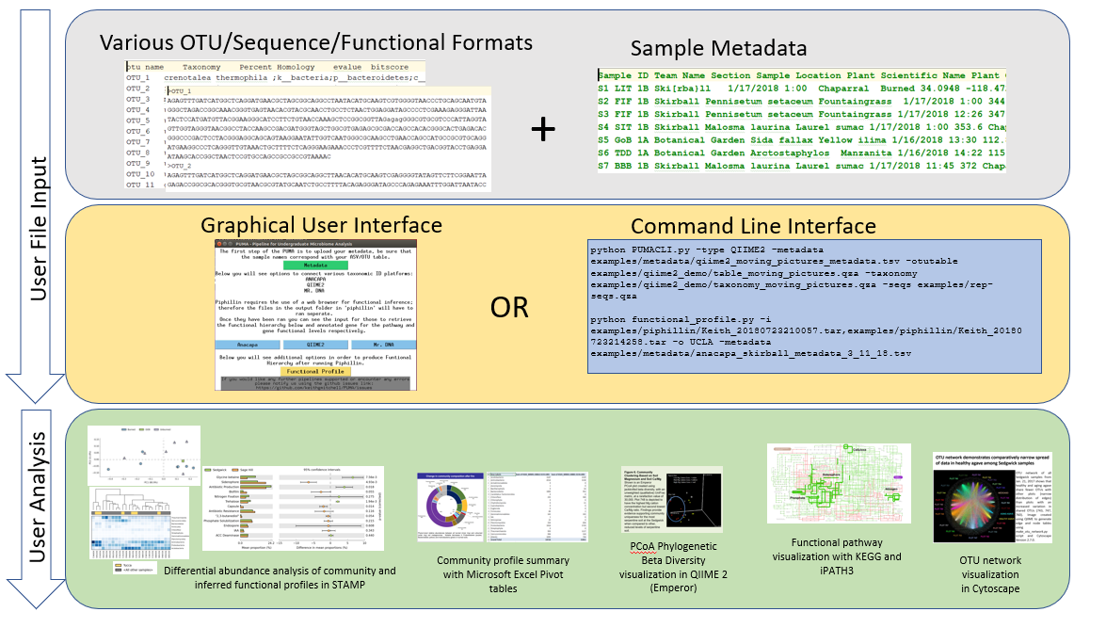

Slide 7
Running PUMA
PUMA provides both a Command Line Interface (CLI) as well as a Graphical User Interface (GUI) to accommodate a larger spectrum of potential users. The graphic user interface is ideal for students and or researchers with no experience on UNIX based systems that are interested in quickly visualizing their 16S rRNA microbiome data. A CLI version is implemented to allow users with UNIX experience, or those who are interested in learning, to customize their analysis and build upon/automate the provided scripts [12].
Running the PUMA CLI (Command Line Interface)
The necessary commands in order to run the CLI version of PUMA depend on the platform and are documented at the PUMA github README.md.
python PumaCLI.py
-otutable examples/anacapa_skirball_S18/16S_ASV_raw_taxonomy_70.tsv
-fwdseq examples/anacapa_skirball_S18/nochim_forward16S.fasta
-mergeseq examples/anacapa_skirball_S18/nochim_merged16S.fasta
-reverseseq examples/anacapa_skirball_S18/nochim_reverse16S.fasta
-rarefactioniter 3
-rarefactiondepth 3500
-metadata examples/metadata/anacapa_skirball_metadata_3_11_18.tsv
-type anacapa
-unique_id demo
-msa_phylo True
python PumaCLI.py -type MrDNA -metadata examples/metadata/mrdna_F15_mock_metadata.tsv -otutable examples/mrdna_F15/112415KR515F-pr.fasta.otus.fa.OTU.txt -seqs examples/mrdna_F15/sequences.fasta
python PumaCLI.py -type QIIME2 -metadata examples/metadata/qiime2_moving_pictures_metadata.tsv -otutable examples/qiime2_demo/table_moving_pictures.qza -taxonomy examples/qiime2_demo/taxonomy_moving_pictures.qza -seqs examples/qiime2_demo/rep-seqs.qza
python functional_profile.py -i examples/piphillin/Keith_20180723210057.tar,examples/piphillin/Keith_20180723214258.tar -o UCLA -metadata examples/metadata/anacapa_skirball_metadata_3_11_18.tsv
Running the PUMA GUI (Graphical User Interface)
To ensure stable environment for running the program, the graphical user interface is built to be run on the QIIME 2 pre-configured virtual machine, upon which a few python libraries are automatically installed [39].
After following the steps at the github in regards to the setup of PUMA on the GUI the user is presented with a screen as presented in Figure 3. The box shown in green is completed first as the user will upload the Metadata for the taxonomic profile they plan to analyze; subsequently the user will upload the files presented by the sequencing platform that they utilized as indicated by the blue boxes in Figure 3. Each blue box, or sequencing/taxonomic identification platform will present another window to the user with the specific files to be uploaded. Finally, the user will navigate to the output folder in the repository that they cloned to retrieve the community analysis files and files to be ran using the Piphillin online tool [40].
Figure 3: PUMA Graphical User Interface
Master display of the PUMA GUI displays the flow of processes as well as the available functionality. The user primarily uploads the their metadata using the Metadata button shown in green; subsequently, the user will select a blue button corresponding to their sequencing service or file format to upload their files and run community profile processing (e.g. Anacapa, QIIME 2, Mr. DNA). Following running Piphillin the user will select the Functional Profile button in yellow to upload the .tar files produced from Piphillin.

